Slide 1
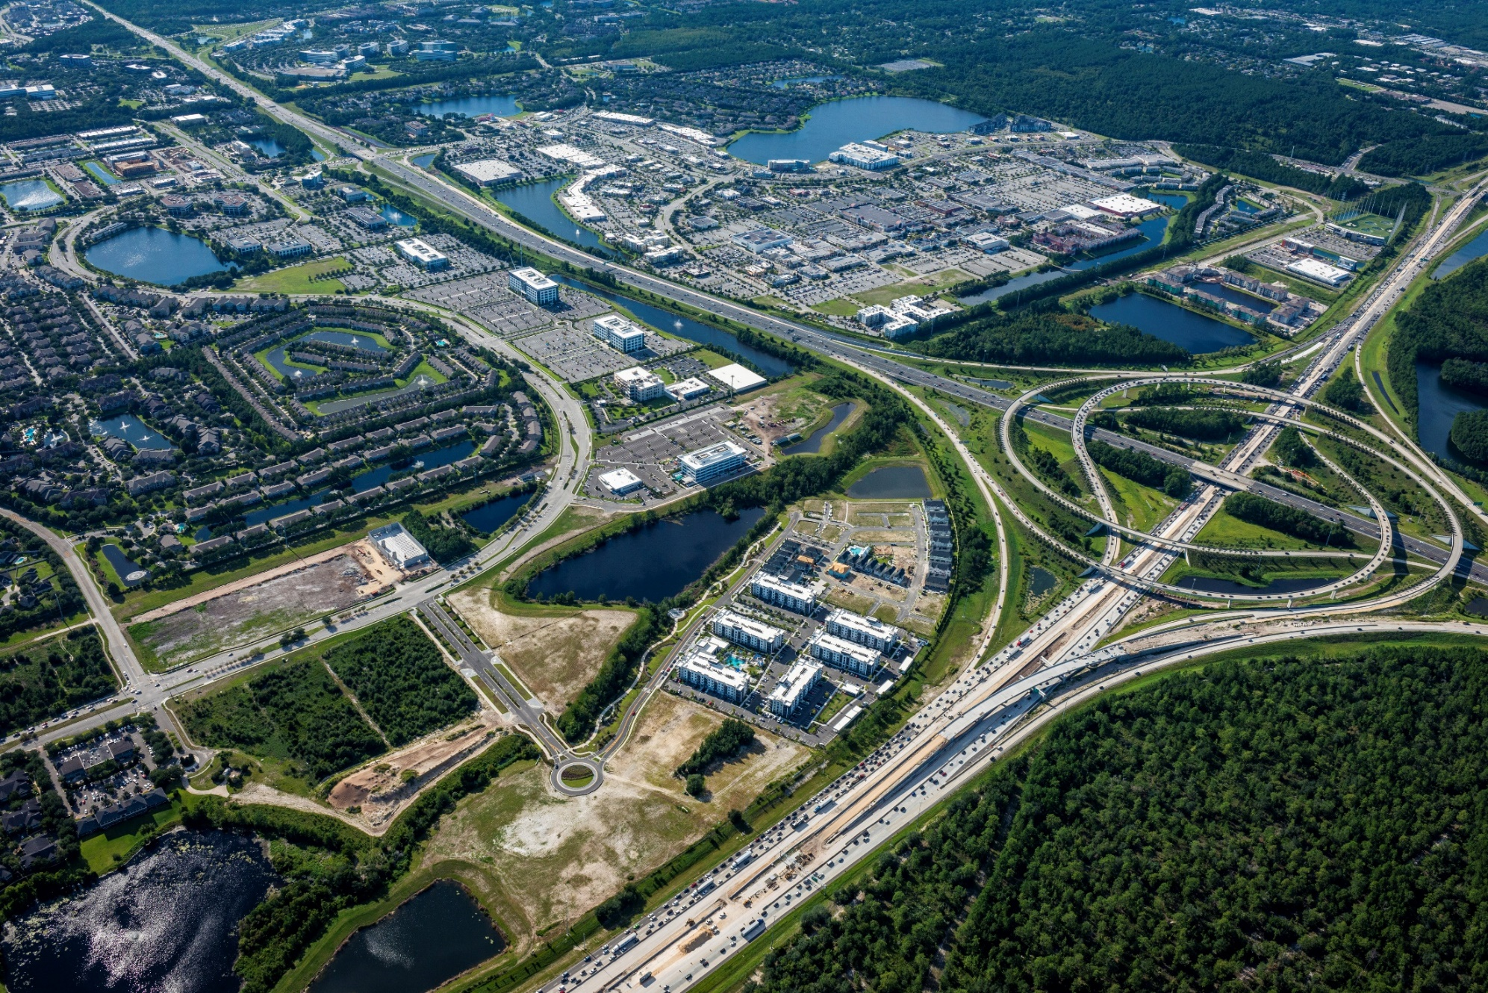
Southside Quarter Commercial Parcels Available
Retail, Office, Hotel, Residential
Lane Gardner
(904) 599-9001
Lane.Gardner@Hines.com

Slide 2
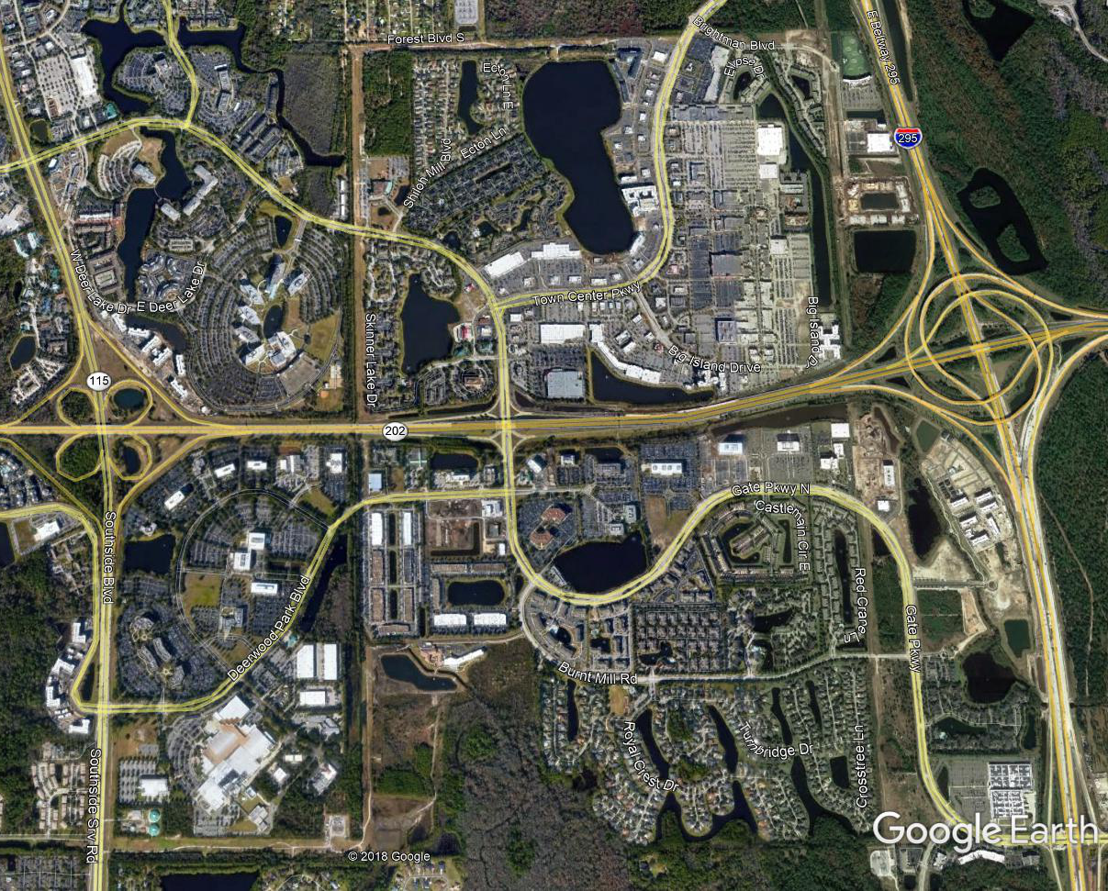
submarket overview
Southside is the largest submarket and new epicenter of Jacksonville
69,000 office jobs in the area
+ 16.3M SF of office space
+ 3.5M SF of retail
5,210 Multifamily units
McKesson, Availity, Web.com recently relocated, increase of + 2,000 office jobs
St. Johns Town Center is regional destination for shopping, dining, and entertainment
University of North Florida enrolls 16,000+
Mayo Clinic is 10 minutes away
15 minutes from downtown and the beach
+ 1,650 residential units
Confidential and Proprietary

Slide 3
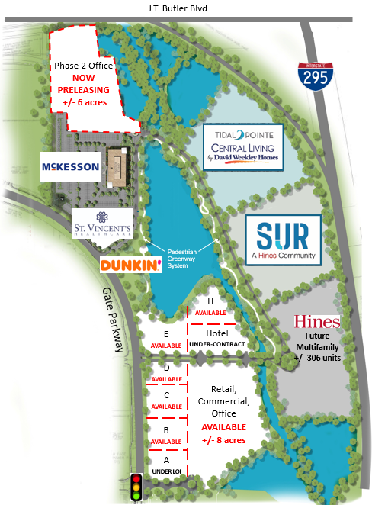
Southside quarter
Best location in Jacksonville’s most active submarket
Retail, office, hotel, residential, and green space in an integrated walkable environment developed by Hines
McKesson’s medical surgical division recently occupied 125k sf office, bringing 700-800 employees
SUR, Hines developed 306-unit luxury apartment in lease up (currently 82% leased)
Hines to develop Phase 2 multifamily with + 306 units
Tidal Pointe by David Weekly, 135 homes for sale
St. Vincent’s Urgent Care, opened Q1 2019
Dunkin’ Donuts, scheduled to open May 2020
Hotel under contract and additional activity on outparcels
Confidential and Proprietary

Slide 4
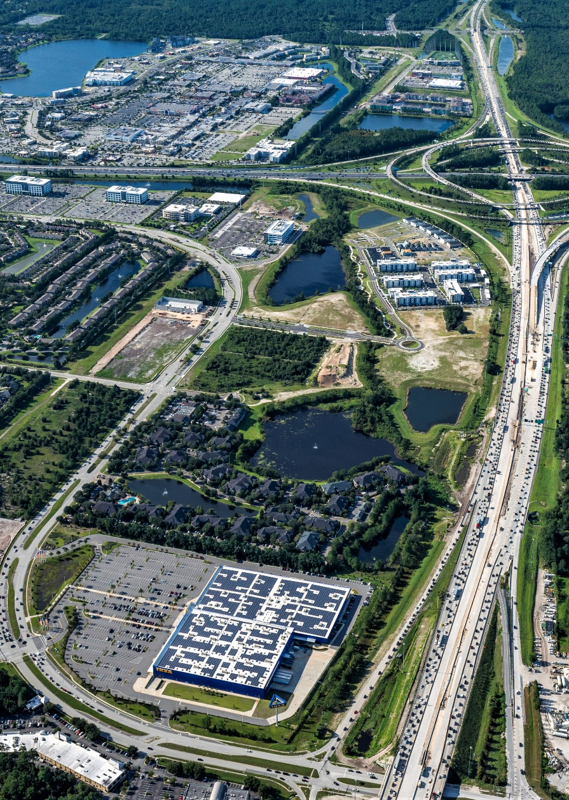
Site overview
5 to 7 acres available
80,000 to 100,000+ square feet available
Site is fully entitled, zoned, and ready for development
No on site detention required, master storm water system in place
Convenient access to I-295 and J.T. Butler Blvd. + 243,500 AADT
Highly visible site
Pylon signage available along I-295
Directly adjacent to high-quality office tenants, McKesson, Availity, Web.com, Deutsche Bank
A unique opportunity to be part of a Hines market defining mixed-use project in Jacksonville’s fastest growing submarket.
+ 128,500 AADT
+ 118,000 AADT
Confidential and Proprietary

Slide 5
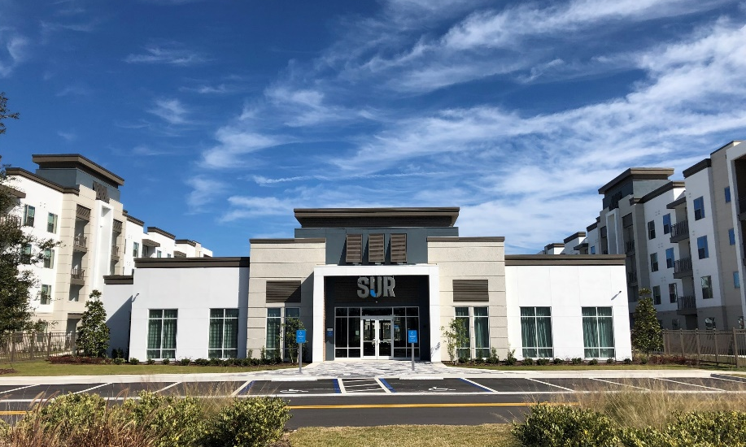
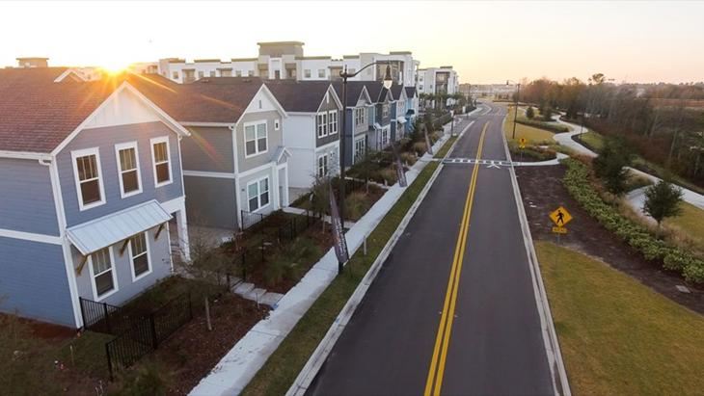
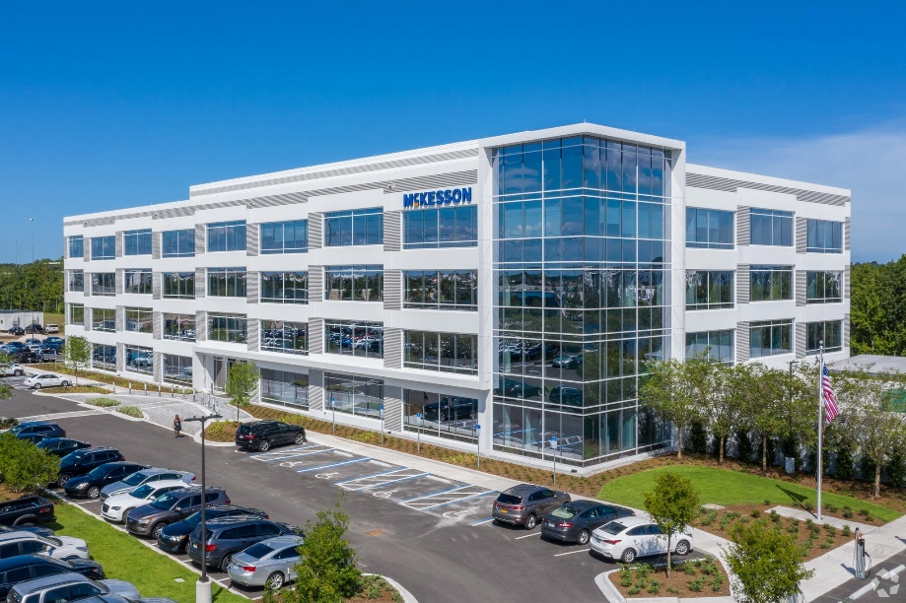
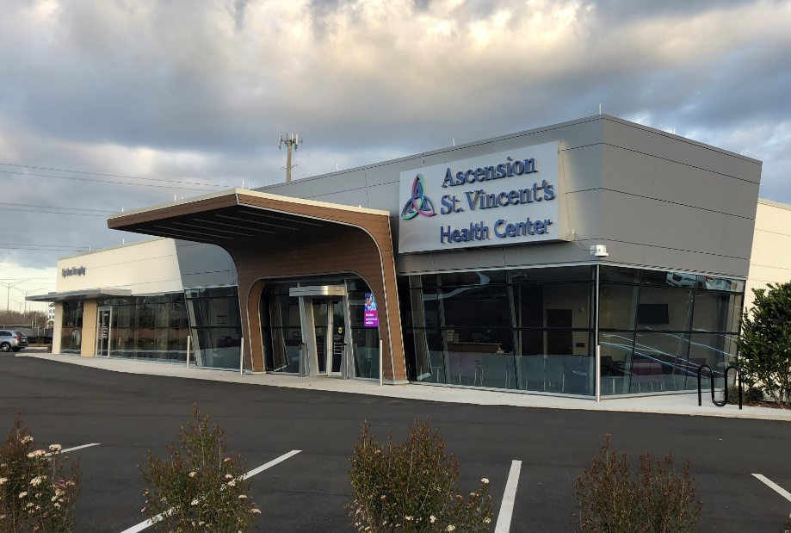
Live-work-play
Confidential and Proprietary

Slide 6
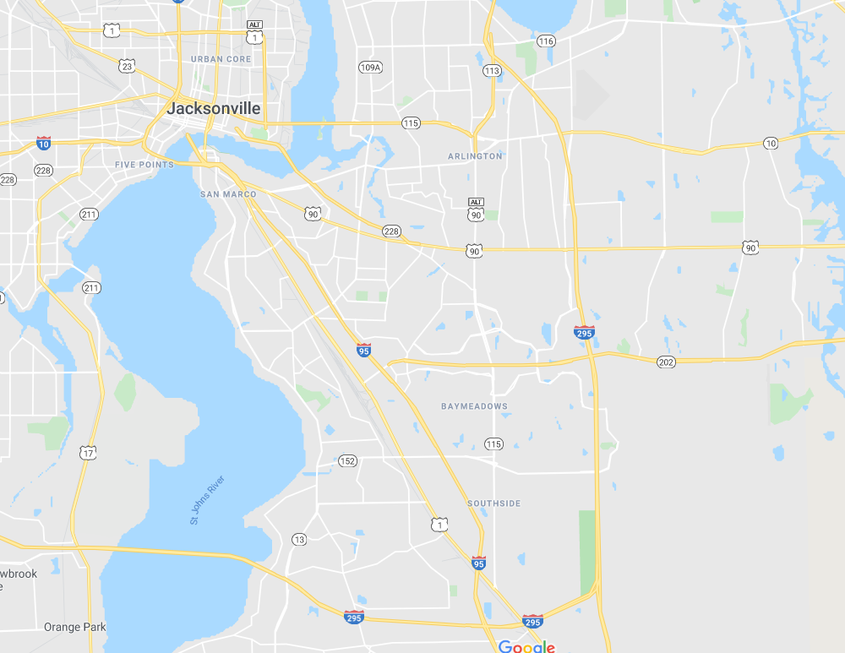
Demographic overview
 | 1-mile | 3-mile | 5-mile
2019 Total Population | 6,363 | 61,446 | 153,300
2024 Total Population | 6,857 | 65,928 | 164,231
2019-2024 Population Growth | 7.76% | 7.29% | 7.13%
2019 Average HH Income | $98,554 | $84,055 | $82,331
2019 Daytime Employment | 9,339 | 43,810 | 118,183
Confidential and Proprietary

